Slide 1

SIGN-UP EVENT in GUI
STUDENT NAME: ANNIE DEQUIT
INSTRUCTOR: Dr. FATEMA NAFA
CSC 115

Slide 2
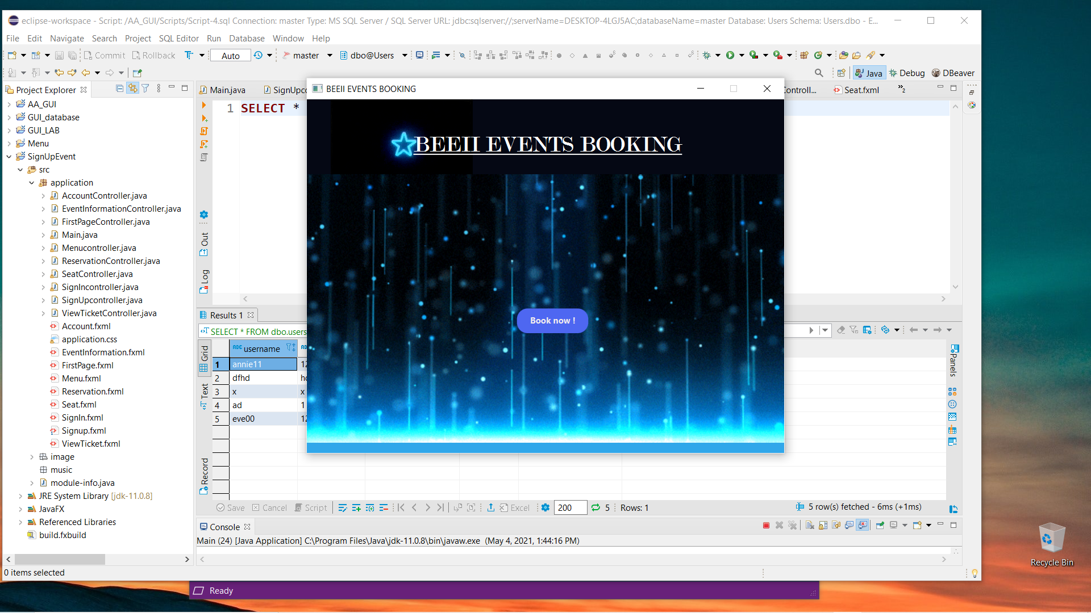
This is the first page of my program when my program is launch, when u click book now it will go to the sign up page

Slide 3
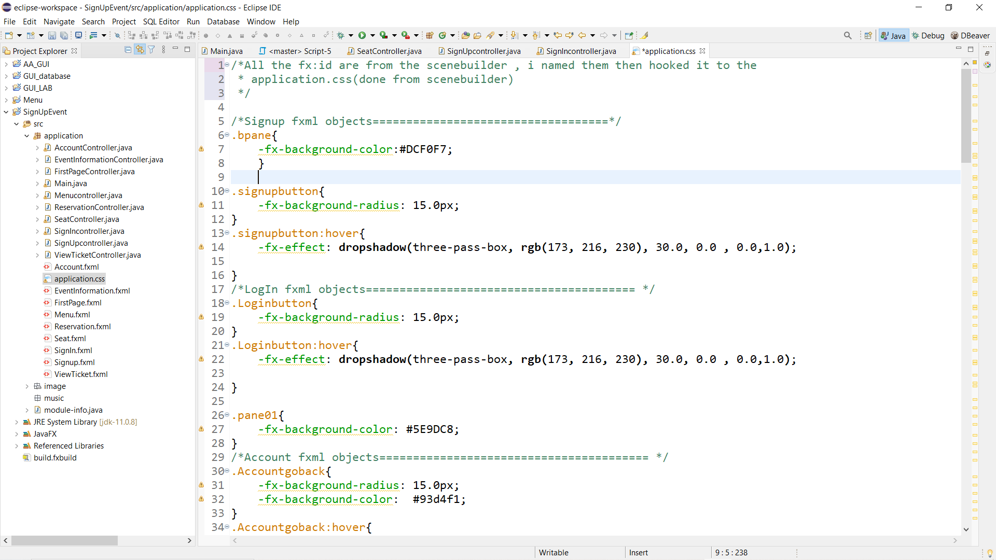
This is my css for this project , it has some of the buttons, pane ,border pane and other objects. Some of the objects on my GUI is colored and designed directly from the scene builder. But here, I put some of its fx id’s to change the color of buttons or to put some effects when mouse is hover in the button

Slide 4
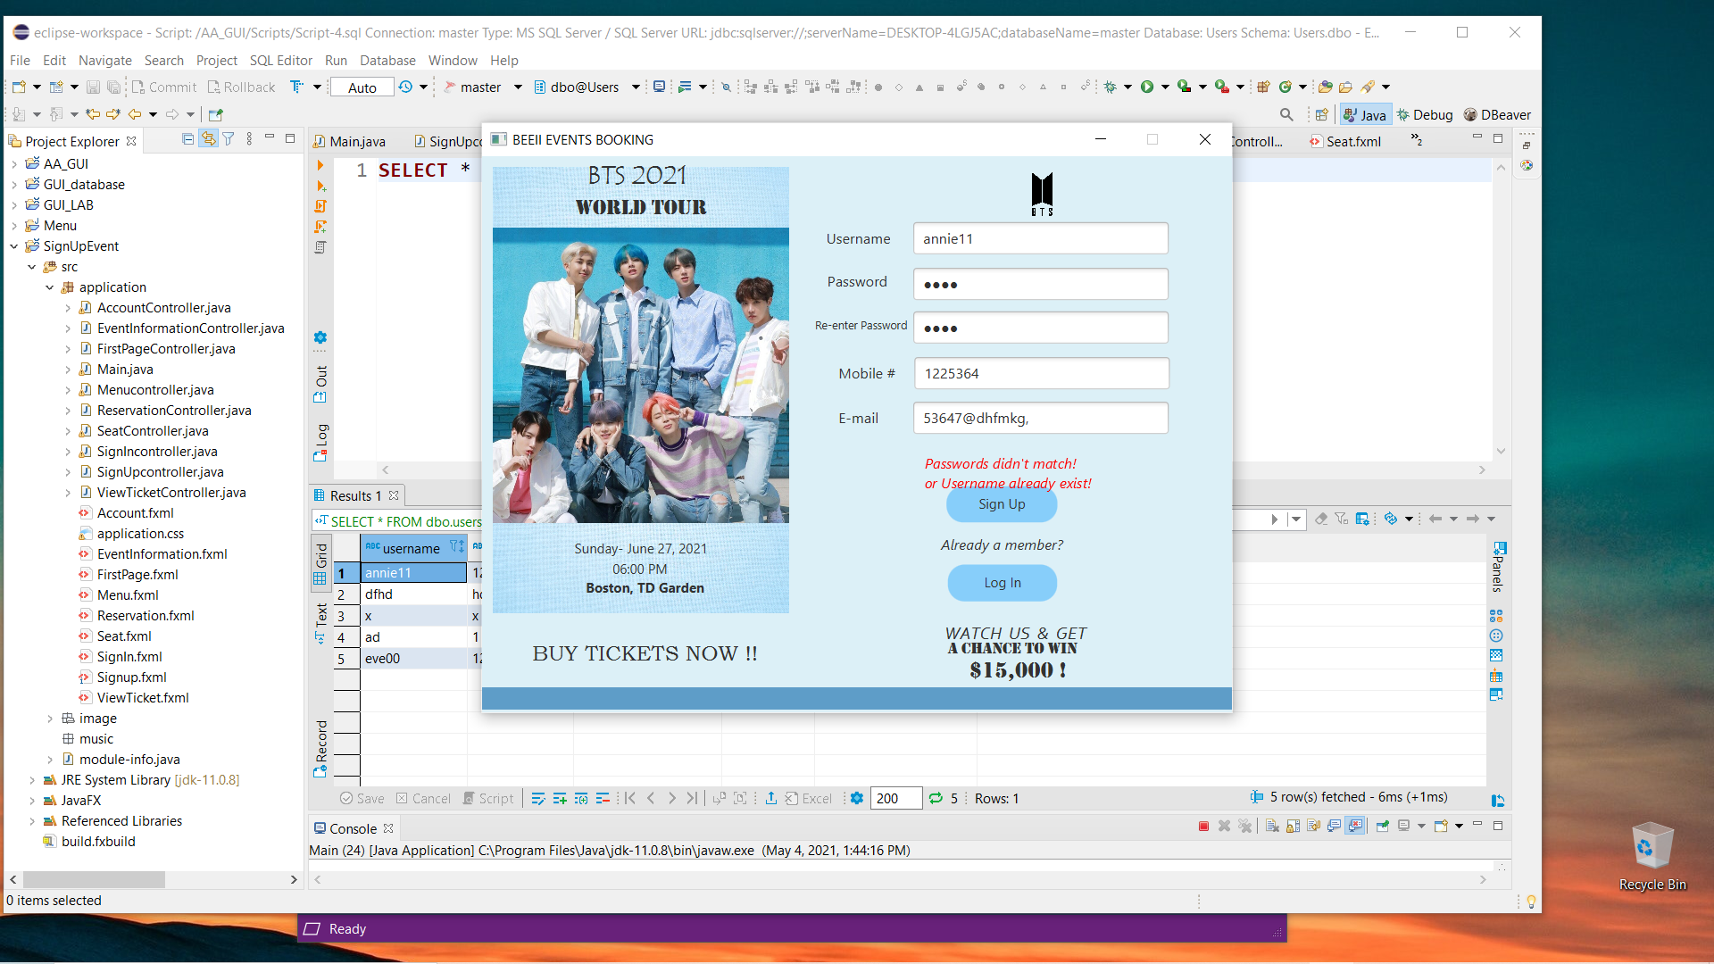
This is the sign-up page…. The code will be on the next slide, also in each fxml file I have one controller class to control its elements (buttons, textfield, the conditions when user put info)

Slide 5
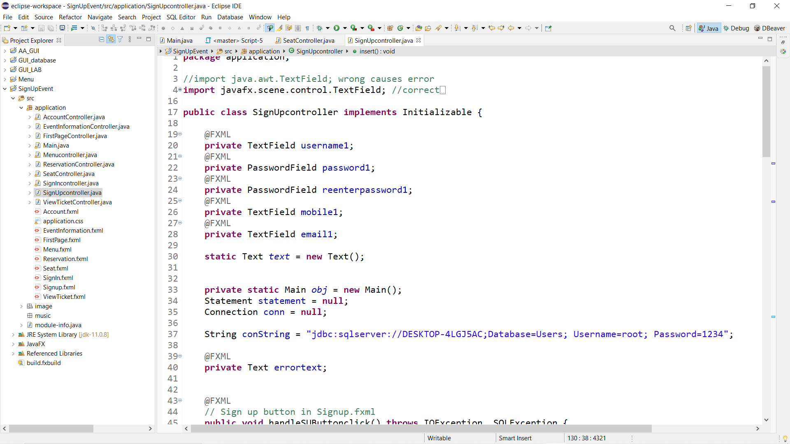
The code for the sign-up page

Slide 6
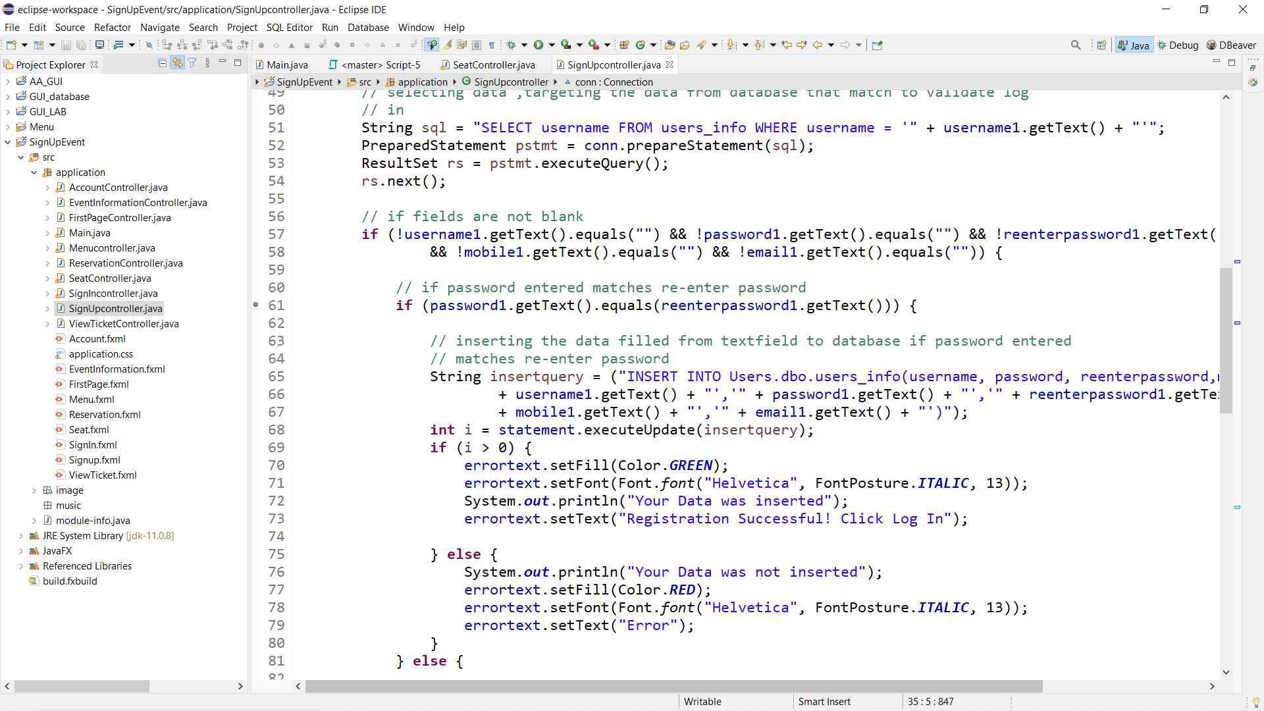
Here you’ll get the if else condition if the username already exist or if the fields are empty, or if the password didn’t match it will not save into the database and will say error

Slide 7
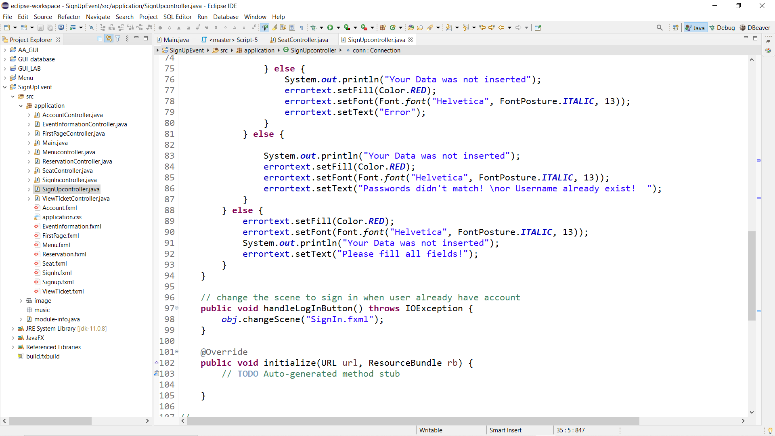

Slide 8

Here everything is okay, I still have to code for the email and mobile to only have valid email or for mobile to only allowed int data..but right now it is registered because the username and password is okay.

Slide 9

If all the TextFields are not filled, it will say the error( Please fill all fields)

Slide 10
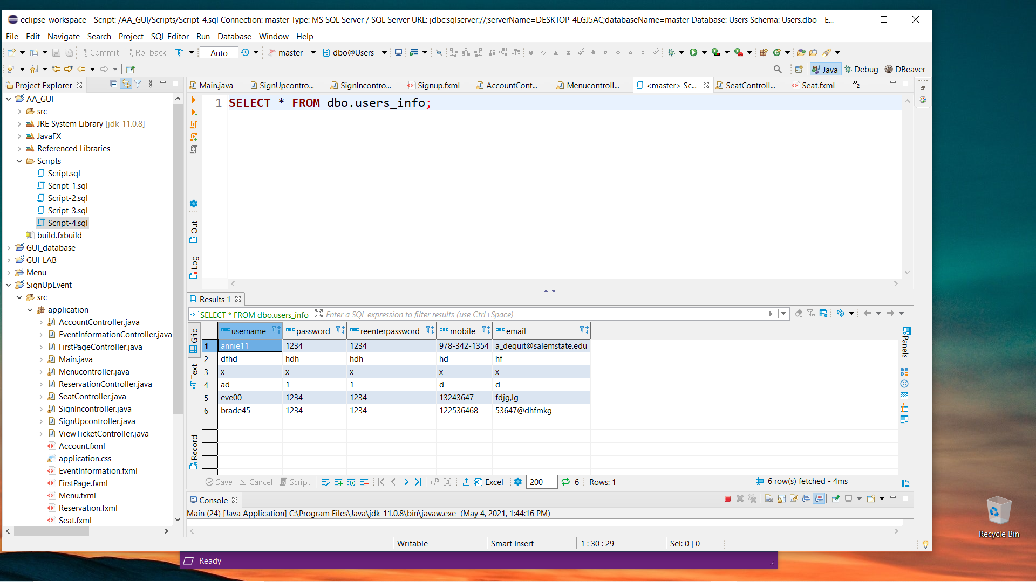
Here the data we entered went successfully in the database table

Slide 11
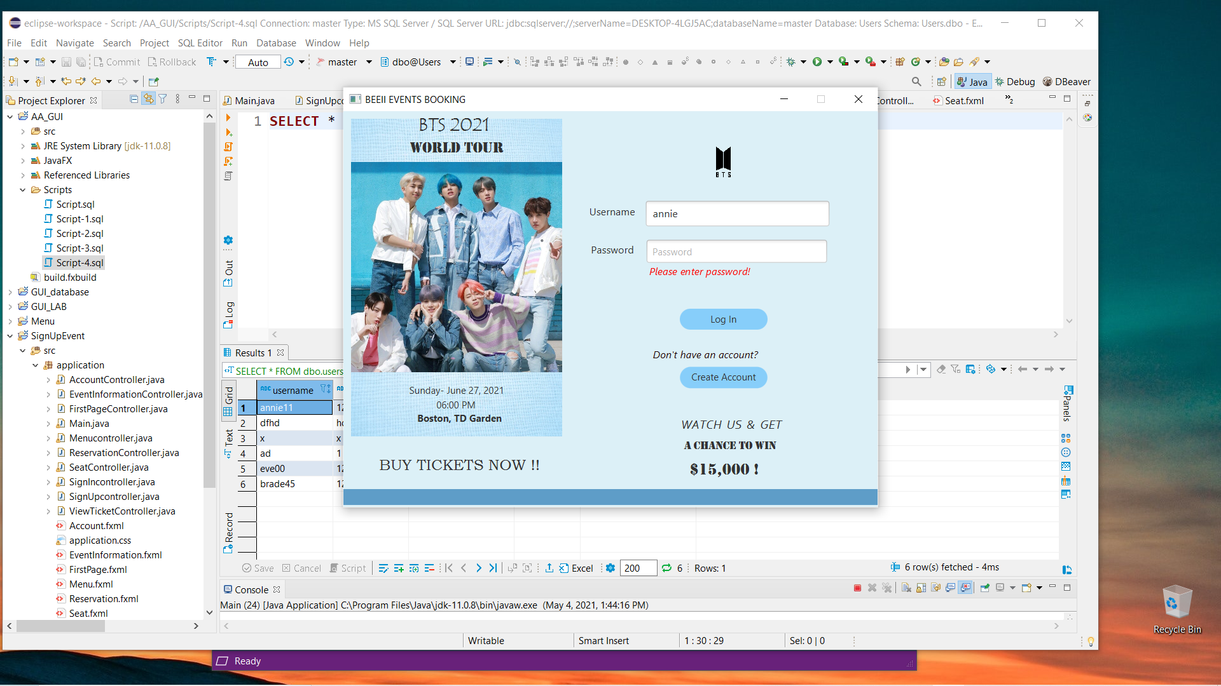
Now the Log-In page , and the code for this GUI ( its conditions, button functions will be on the next slide) Here the password is empty so it will show an error ( Please enter password!)

Slide 12

The textfields input from user is compared to our database if it doesn’t match it will say an error (Incorrect password or username)

Slide 13
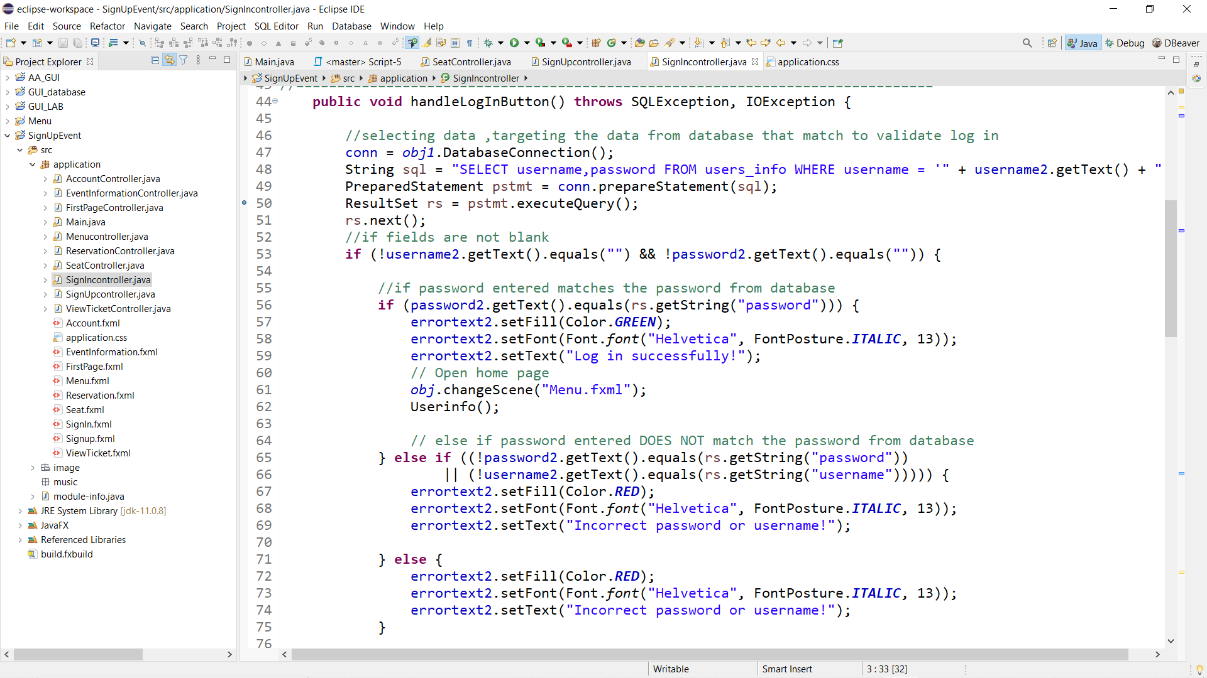
This is the condition from the code behind that GUI in the previous slide

Slide 14
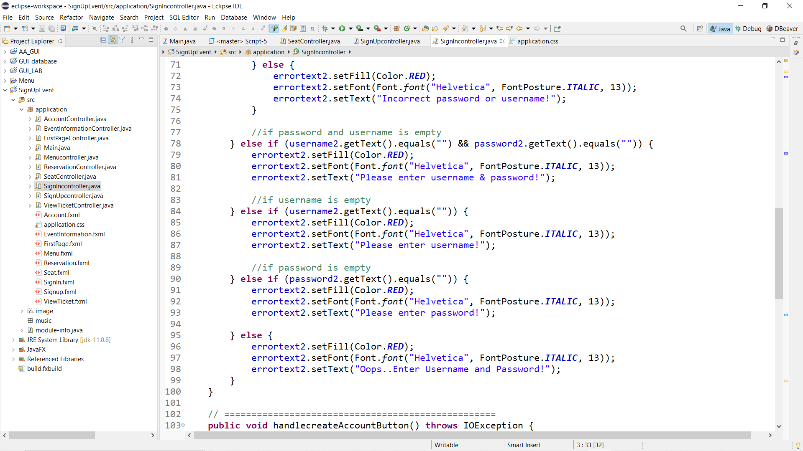

Slide 15
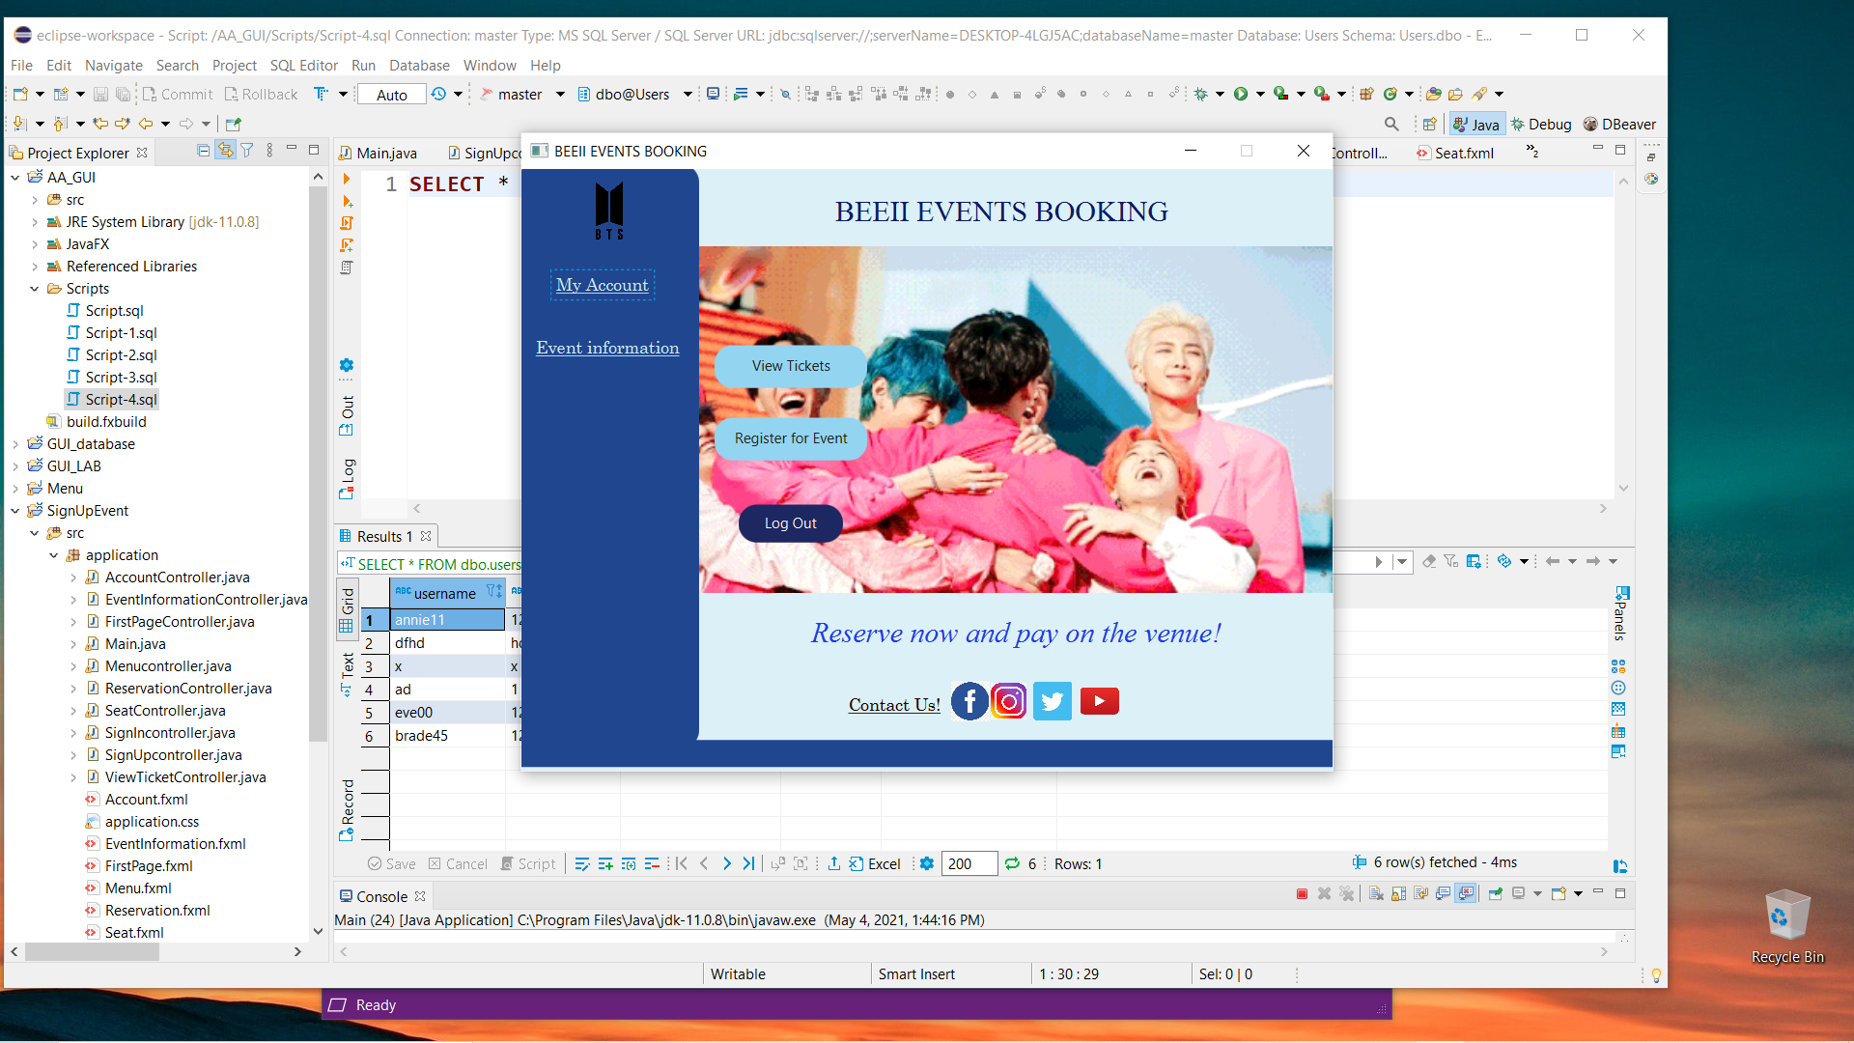
When data entered in the TextField matches in the database it will open the Menu

Slide 16
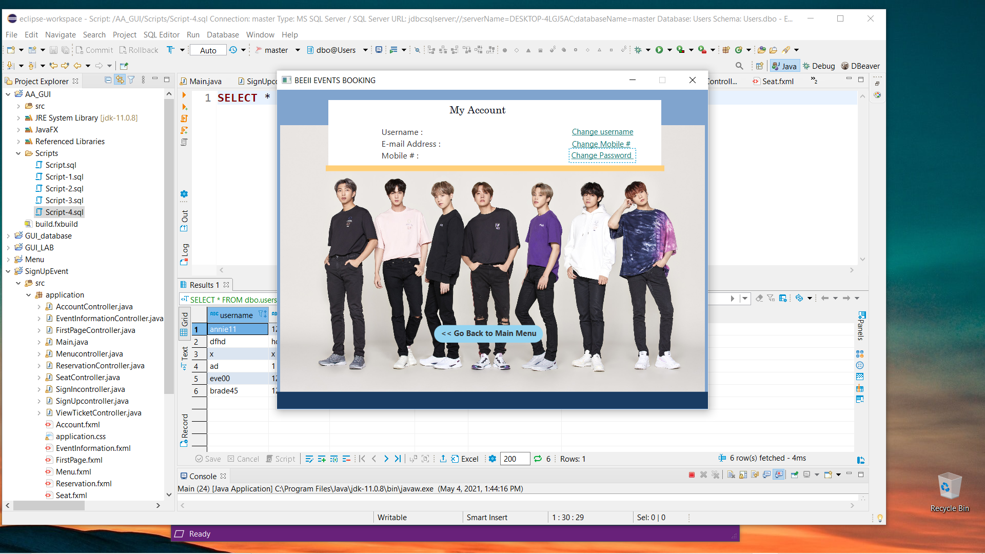
The GUI when “Account” is clicked on the Menu

Slide 17
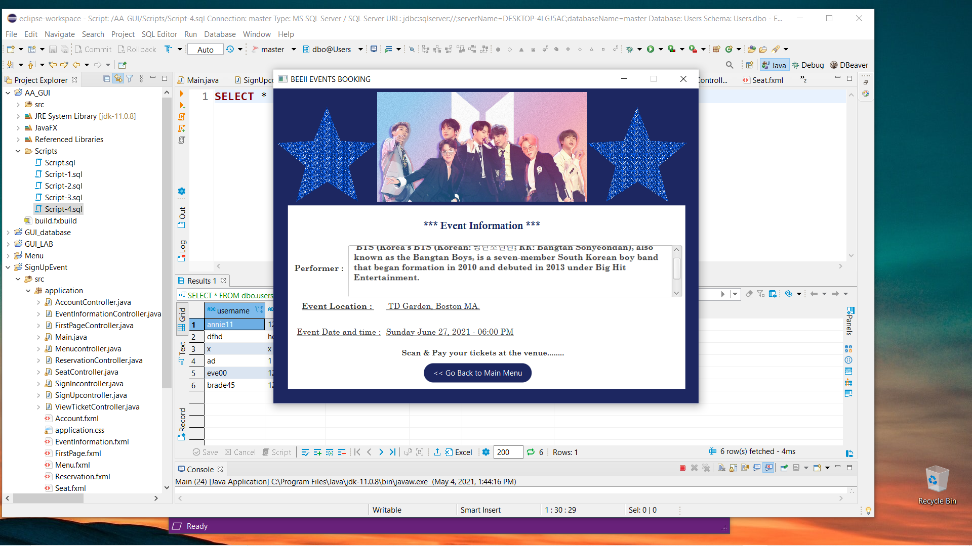
The GUI when “Event Information” is clicked on the Menu

Slide 18
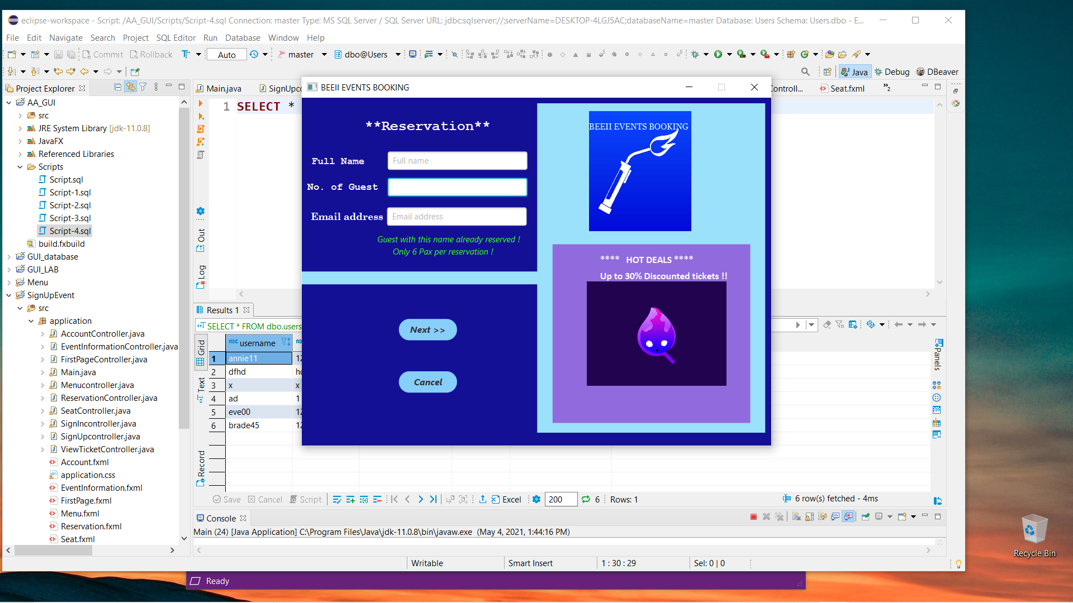
When “Register for event” is clicked on the Menu this will show up, here the error texts are still not programmed so I just left it for now.

Slide 19
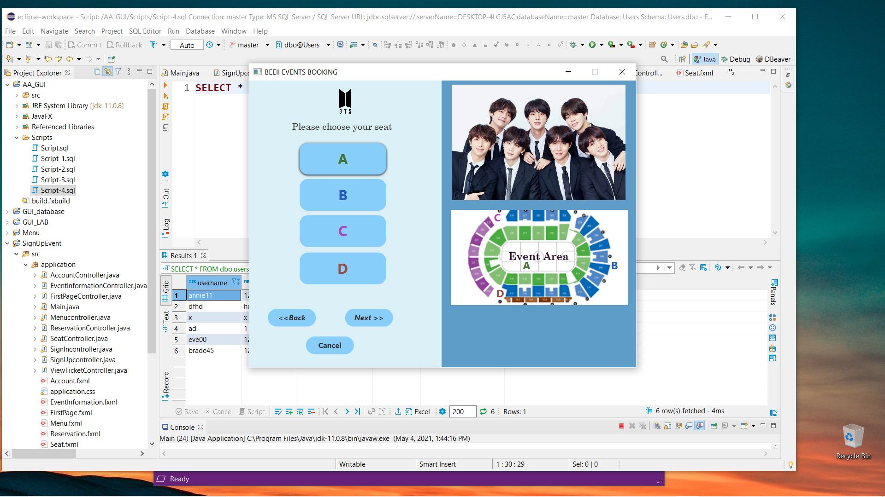
When you click next from the reservation this will show up where you can choose the seat area for the concert

Slide 20

Everytime you click on A . B , C, D it will show up a text that you chose that seat area

Slide 21

Everytime you click on A . B , C, D it will show up a text that you chose that seat area

Slide 22
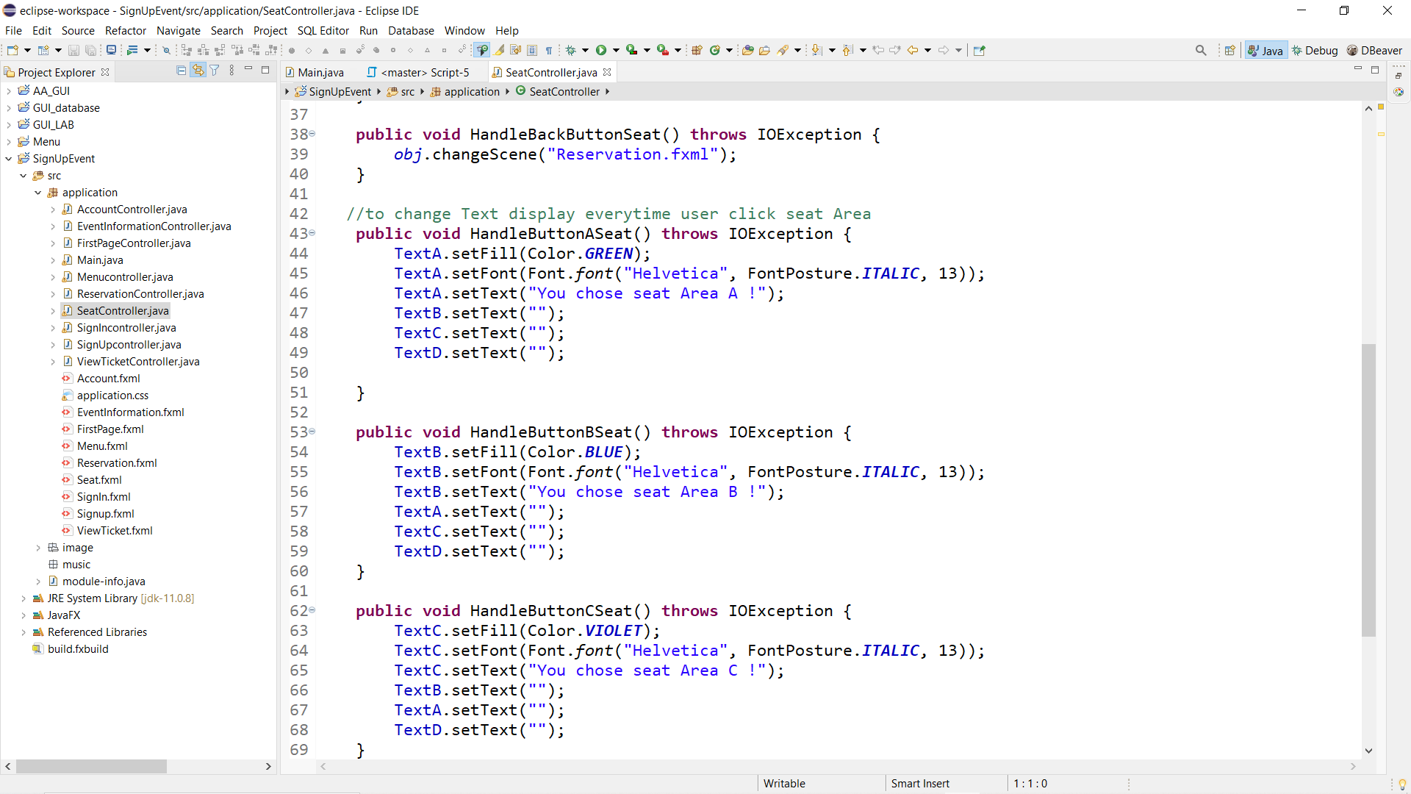
The code behind that function

Slide 23
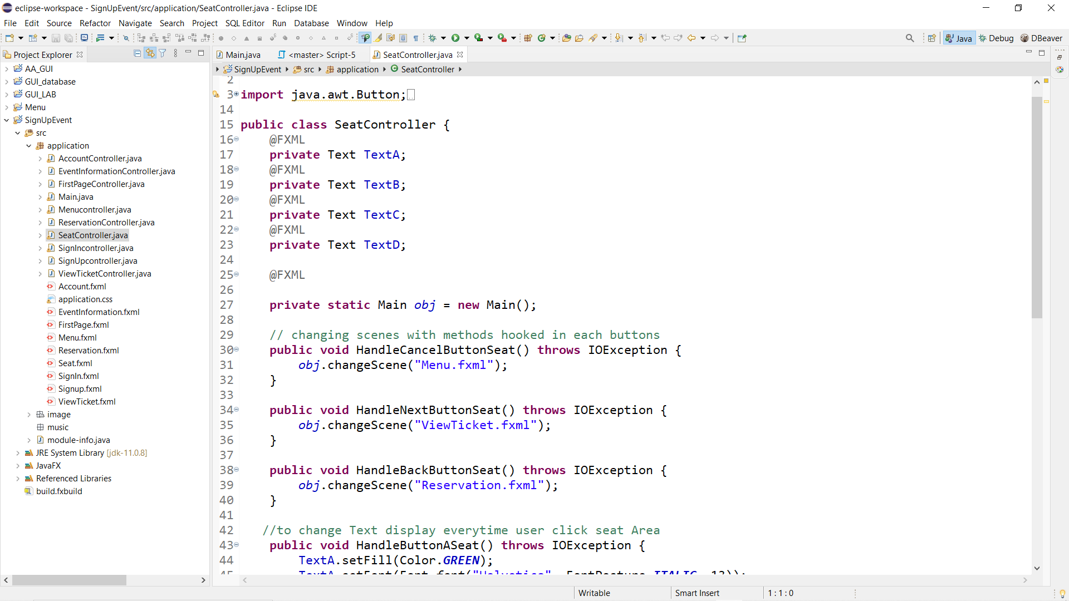

Slide 24
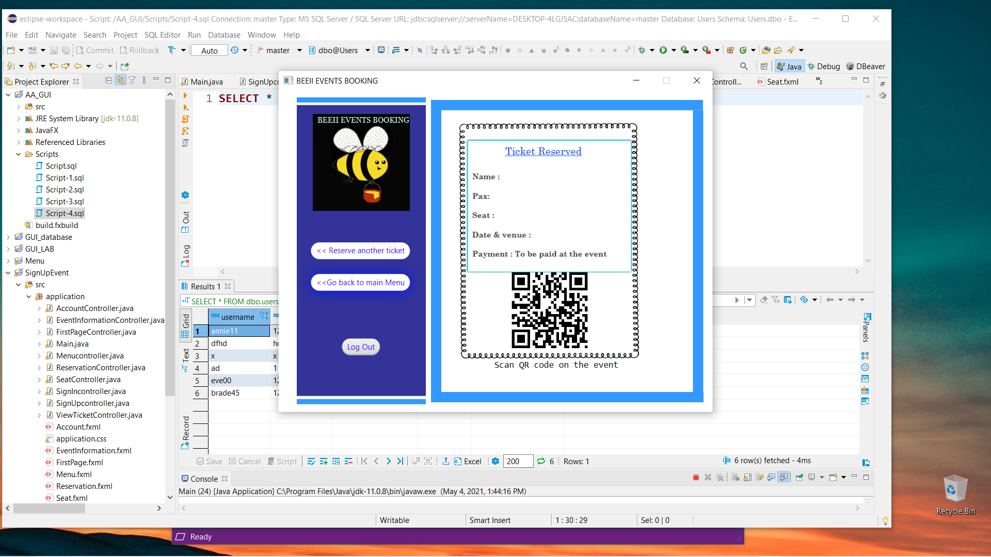
This is the last slide for this Presentation. Here is the ticket reserved GUI. I can easily get user info from database and have them show up here. However, I’m still working on how to get the exact information from the user who log in in the previous GUI(Log In). I am planning on storing the data in each log in . So, I probably have to make separate database in each user that way I can access it all separately and it will not mixed up with the other users information.

